Slide 1
Turbulent Combustion
N. Peters
International Combustion Institute Summer School
Procida 31 May - 5 June, 2015.
Ref. Chapters 10-15 of Combustion Theory,
CEFRC Summer School, Princeton June 28th- July 2nd, 2010
http://www.itv.rwth-aachen.de/fileadmin/Downloads/
Summerschools/Peters_Summerschool_reference.pdf

Slide 2
Table of contents
Lecture 1: Introduction and Statistical Description and Scales
Lecture 2: Species Concentrations, the mixture fraction and
the adiabatic flame temperature
Lecture 3: Balance equations for reactive scalars
Eddy-Beak-up Model and Eddy Dissipation Model
Transported pdf models
The laminar flamelet concept
The BML model and the Coherent Flame Model
Combustion Modelling by LES
Lecture 4: Premixed turbulent combustion: Fundamental notions

Slide 3
Lecture 5: Premixed Turbulent Combustion: The Regime Diagram
Lecture 6: The Level Set Approach for Turbulent Premixed Combustion: Introduction
Lecture 7: The Level Set Approach for Turbulent Premixed Combustion:
A common G – equation for both regimes
Lecture 8: The Turbulent Burning Velocity
Lecture 9: Nonpremixed Turbulent Combustion:
Experimental data and basic concepts
Lecture 10: Nonpremixed Turbulent Combustion: Modelling
Lecture 11: Two Applications in Gasoline Engines
Lecture 12: Two Applications in Diesel Engines

Slide 4
Lecture 1
Introduction
and Statistical Description and Scales
1.-1

Slide 5
Introduction
Engineering applications are typically turbulent
turbulence models
These models use systematic mathematical derivations based on the Navier-Stokes equations
1. On the integral scales
For mean quantities closure hypotheses (like an eddy viscosity) are introduced that rely on dimensional arguments and require empirical input.
→ semi-empirical nature of turbulence models
1.-2

Slide 6
2. On the small scales:
Equations for two-point correlations or for structure functions are derived from which scaling laws are deduced (Kolmogorov scaling).
Such derivations use the very particular (quadratic) non-linearity of the Navier-stokes equations.
The can not be generalized to other non-linear equations like those in combustion.
1.-3

Slide 7
Nevertheless:
The apparent success of turbulence models in solving engineering problems for non-reactive flows has encouraged similar approaches for turbulent combustion
turbulent combustion models
Problems:
Besides the flow not only chemistry but many other physical effects come in: heat release, radiation, gravity, surface tension,….,
Combustion is a multi-scale multi-physics problem.
1.-4

Slide 8
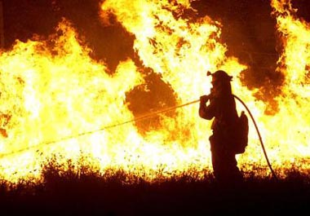
Various chemical time scales + diffusion ⇒ various length scales
Plus turbulence:
at large scales:
Local wind pattern
Radiation
and at small scales:
Turbulent mixing
Burning and Extinction
Smoke generation
Combustion is a multi-scale multi-physics problem
1.-5

Slide 9
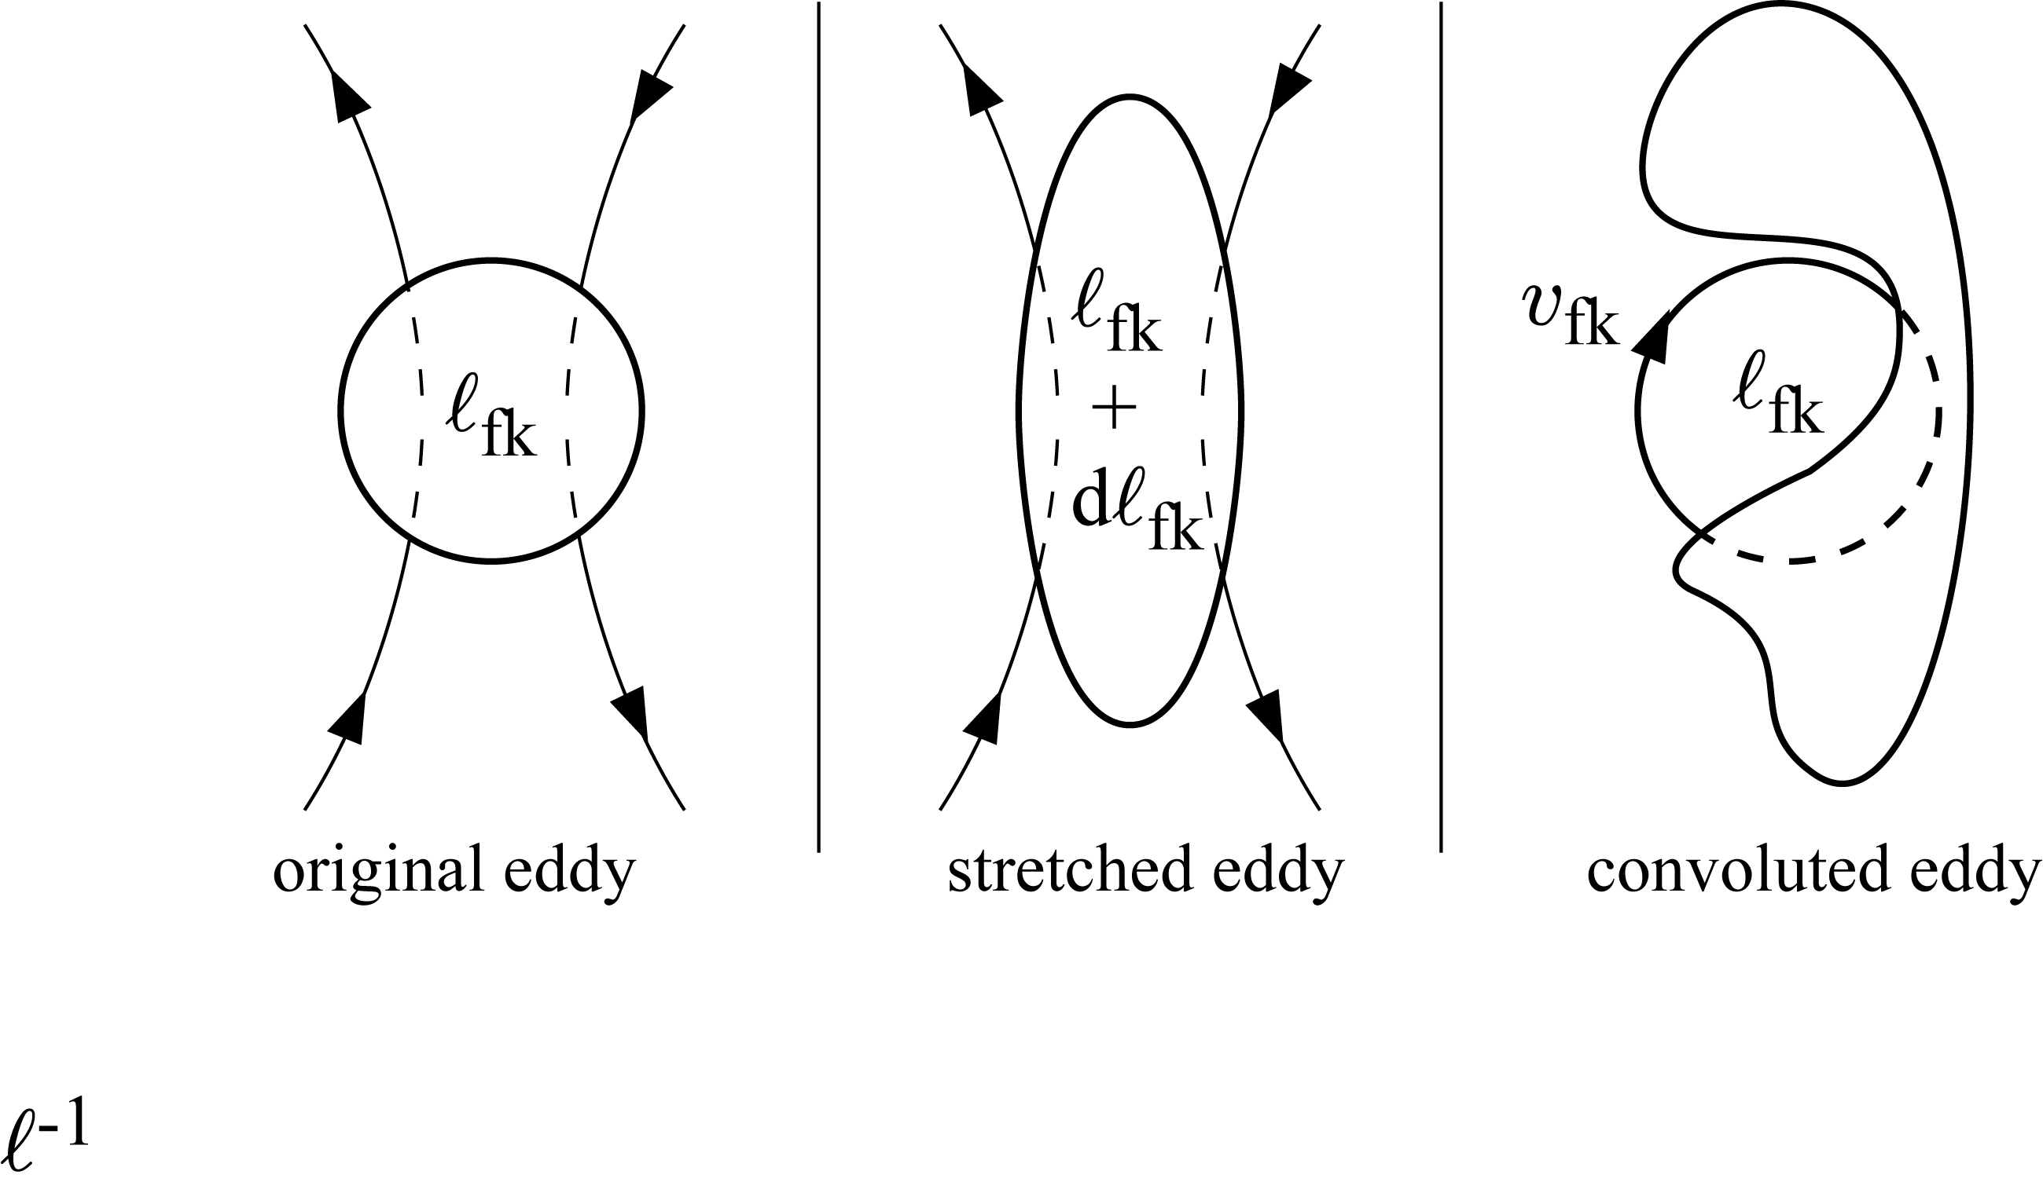
In turbulence alone, the general view is that once a range of different size eddies has developed, shear at the interface between the eddies enhance the mixing.
During the eddy break-up process and the formation of smaller eddies,
shear will increase and thereby steepen the concentration gradients at the interface between reactants, which in turn enhances their molecular interdiffusion.
1.-6

Slide 10
Combustion differs from isothermal mixing in chemically reacting flows by two specific features:
heat release by combustion induces an increase of temperature
increase of temperature accelerates combustion chemistry. Due to the competition between chain branching and chain breaking reactions this process is very sensitive to temperature changes.
1.-7

Slide 11
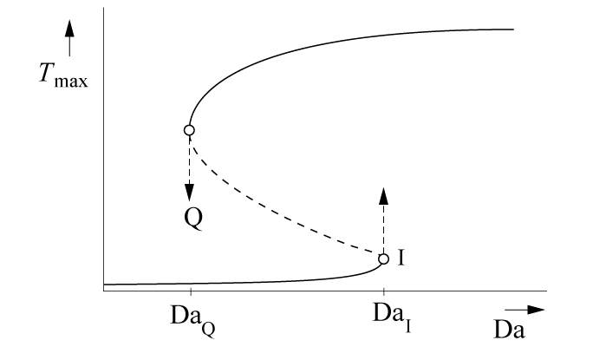
Heat release combined with temperature sensitive chemistry leads to typical combustion phenomena like ignition and extinction.
The maximum temperature in a
homogeneous flow combustor is
plotted as a function of the
Damköhler number, which here
represents the ratio of the
residence time to the chemical time.
This is called the S-shaped curve.
1.-8

Slide 12
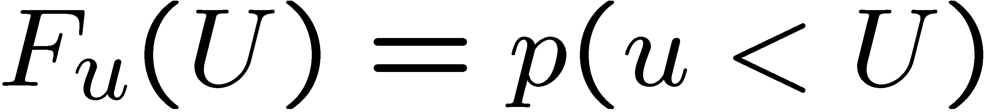
Statistical Description of Turbulent Flows
The aim of stochastic methods in turbulence is the description of the fluctuating
velocity and scalar fields in terms of their statistical distributions.
Distribution function of a single variable of the velocity component u, for instance.
The distribution function F_{u}(U) of u is defined by the probability p of finding a
value of u < U:
U is the so-called sample space variable associated with the random stochastic variable u.
1.-9

Slide 13
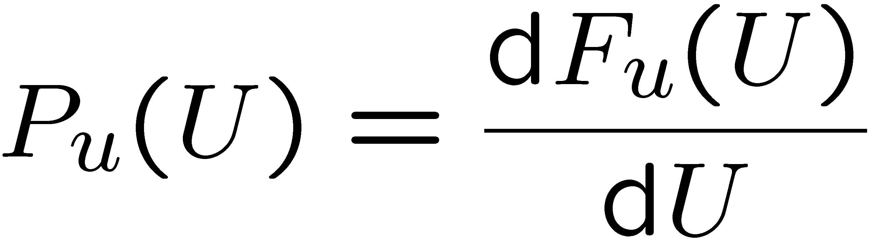
The sample space of the random stochastic variable u consists of all possible realizations of u.
The probability of finding a value of u in a certain interval U₋ < u < U₊ is given by
The probability density function pdf of u is now defined as
It follows that P_{u}(U) dU is the probability of finding u in the range U ≤ u ≤ U+dU.
1.-10

Slide 14
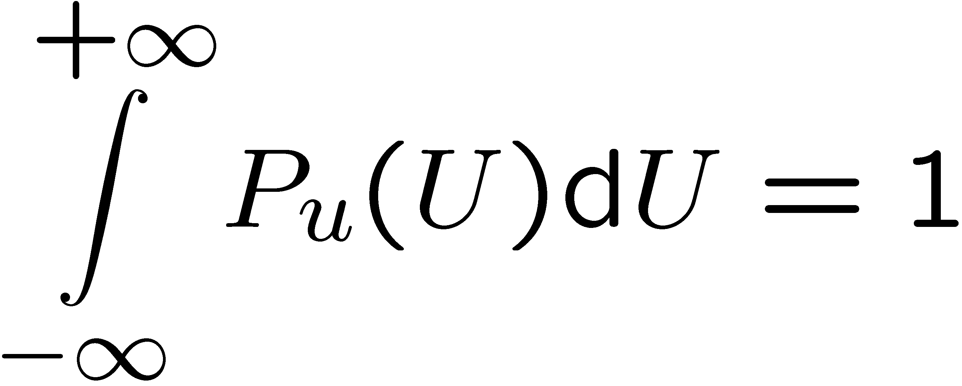
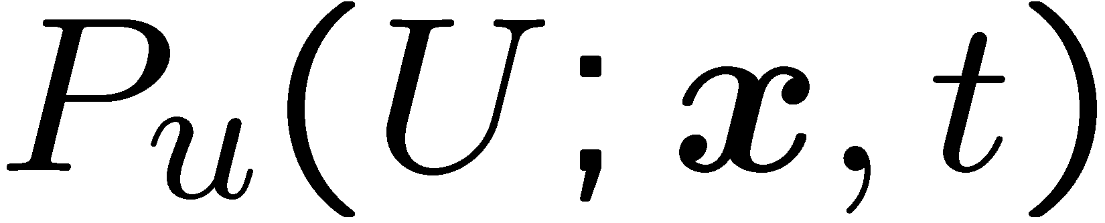
If the possible realizations of u range from -∞ ≤ u ≤ +∞, it follows that
which states that the probability of finding the value u in the range -∞ ≤ u ≤ +∞ is certain, i.e. it has the probability unity.
It also serves as a normalizing condition for P_{u}.
In turbulent flows the pdf of any stochastic variable depends, in principle, on the
position x and on time t.
These functional dependencies are expressed by the following notation
1.-11

Slide 15
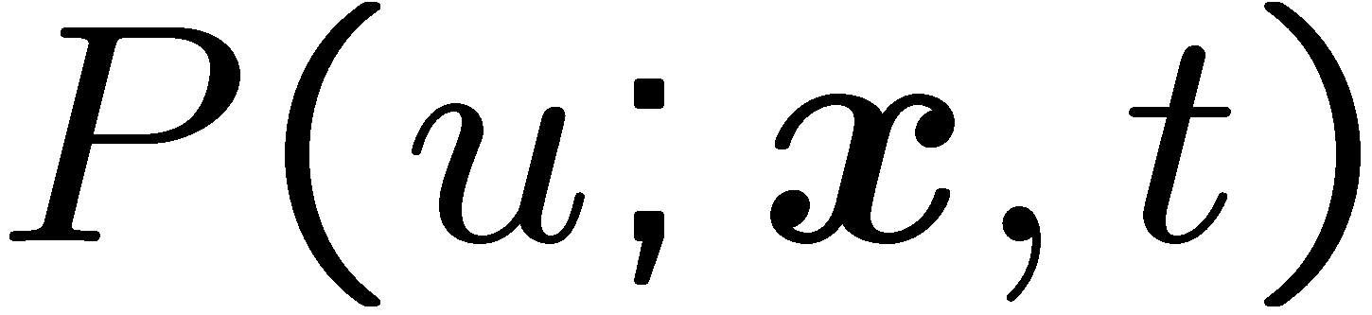
The semicolon used in
indicates that P_{u} is a probability density in U-space and a function of x and t.
In stationary turbulent flows it does not depend on t and in homogeneous turbulent fields not on x.
In the following we will, for simplicity of notation, not distinguish between the random stochastic variable u and the sample space variable U, drop the index and write the pdf as
1.-12

Slide 16
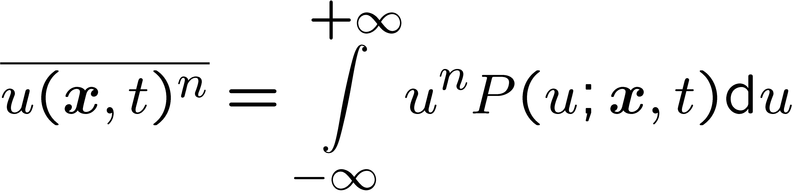
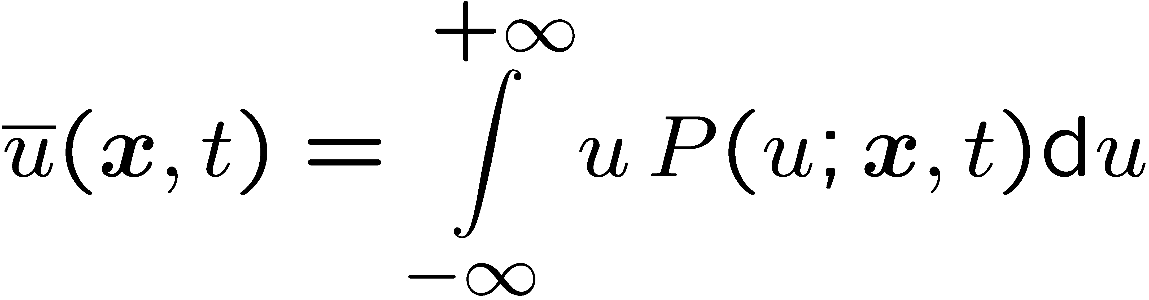
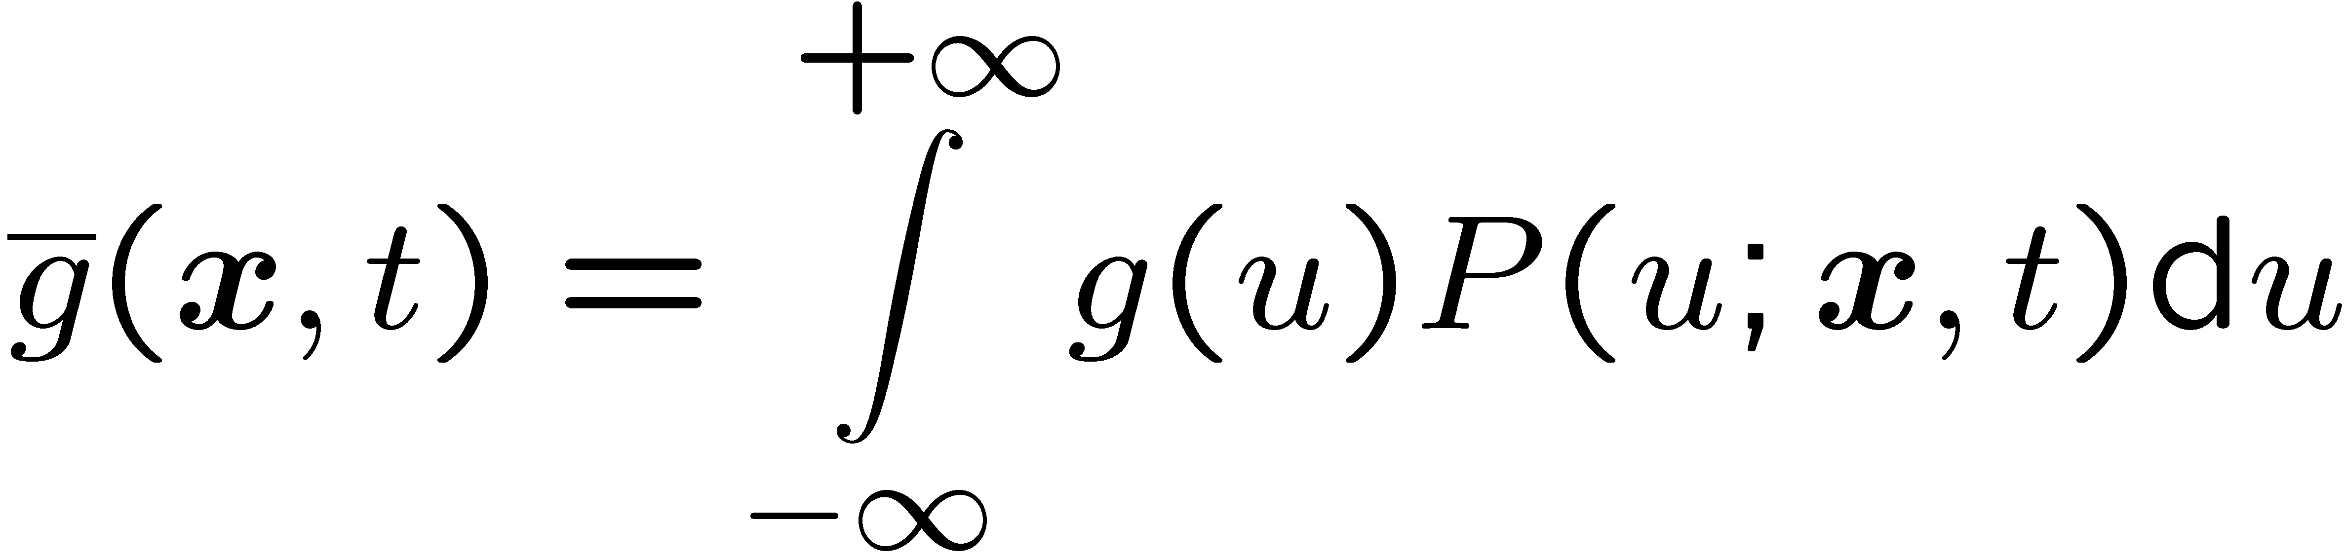
Once the pdf of a variable is known one may define its moments by
The overbar denotes the average or mean value, sometimes also called
expectation, of u^{n}. The first moment (n = 1) is called the mean of u
Similarly, the mean value of a function g(u) can be calculated from
1.-13

Slide 17
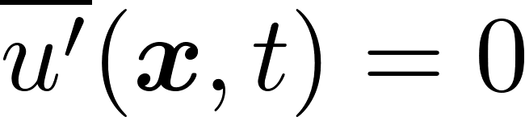
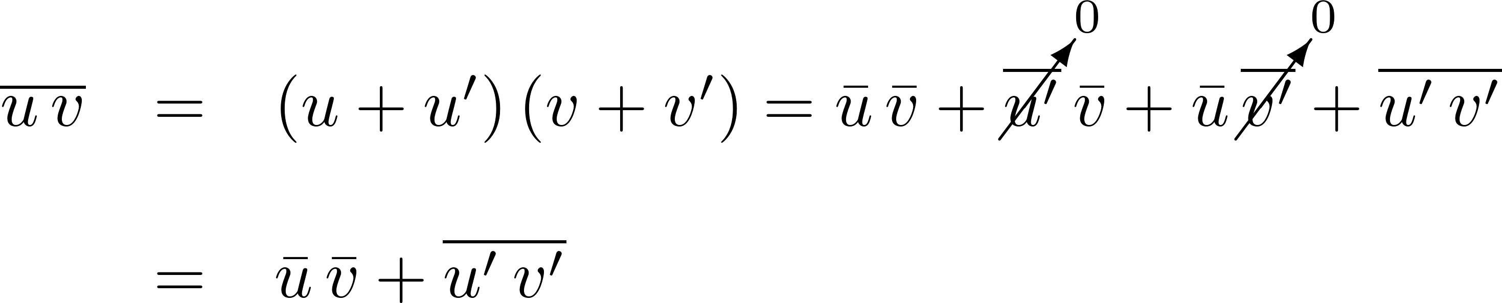
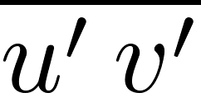


In constant density flows (ρ = const) one also writes
Taking the average leads to
For average of typical products one gets
The product requires closure in terms of and (eddy viscosity hypothesis).
1.-14

Slide 18
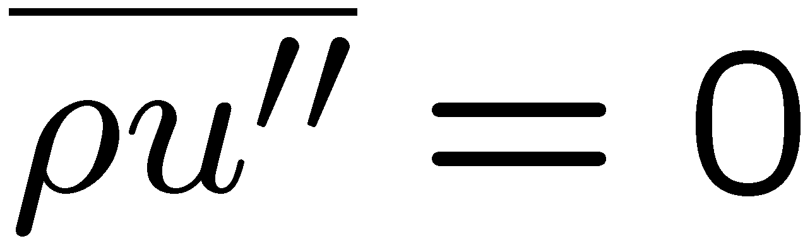
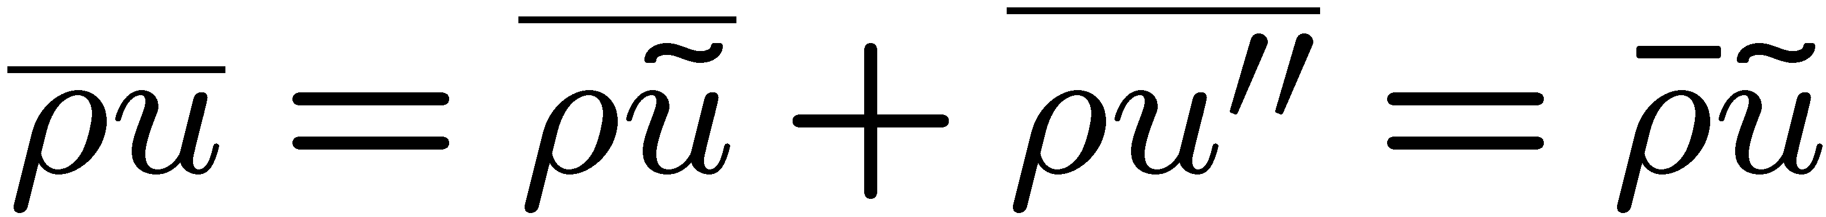
For flows with large density changes as they occur in combustion, it is often convenient to introduce a density-weighted average ũ, called the Favre average, by splitting u(x,t)
This averaging procedure is defined by requiring that the average of the
product of u'' with the density ρ (rather than u'' itself) vanishes
The definition for ũ may then be derived by multiplying
by the density ρ and averaging
1.-15

Slide 19
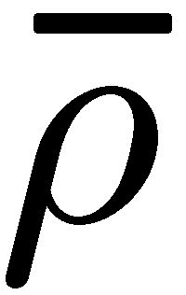
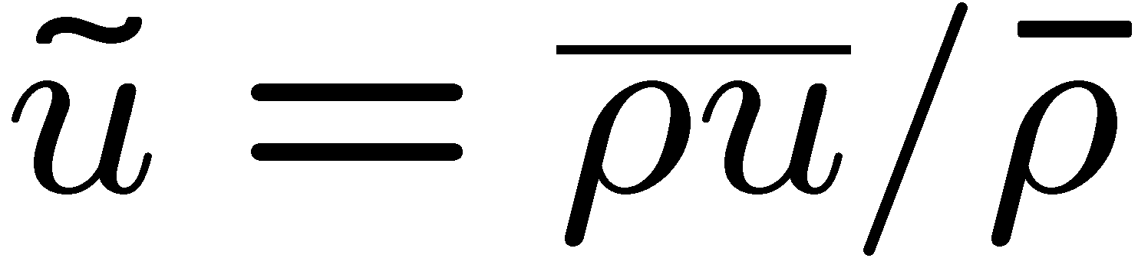
Here the average of the product ρũ is equal to the product of the averages and ũ, since ũ is already an average defined by
This density-weighted average can be calculated, if simultaneous measurements of ρ and u are available.
Then, by taking the average of the product ρu and dividing it by the average of ρ one obtains ũ .
While such measurements are often difficult to obtain, Favre averaging has considerable advantages in simplifying the formulation of the averaged
Navier-Stokes equations in variable density flows.
1.-16

Slide 20
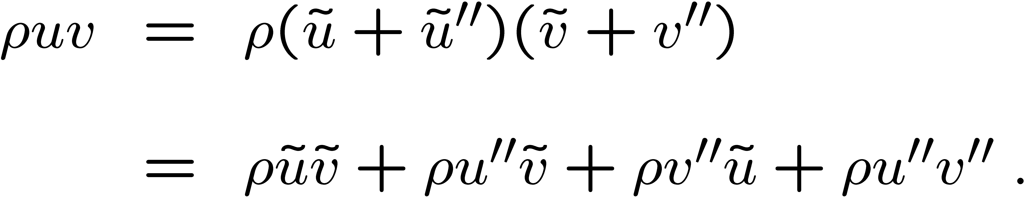
In the momentum equations, but also in the balance equations for the temperature and the chemical species, the convective terms are dominant in high Reynolds number flows.
Taking the average of the product of the density ρ with the velocity components u and v would lead with the conventional averages
to four terms
Using Favre averages instead one writes
Here fluctuations of the density do not appear.
Therefore Favre averaging is the method of choice.
1.-17

Slide 21
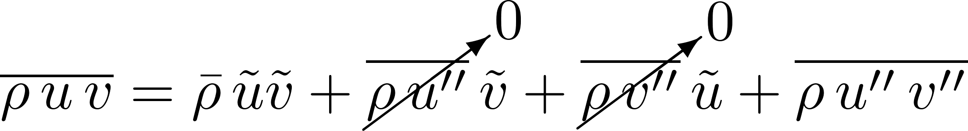
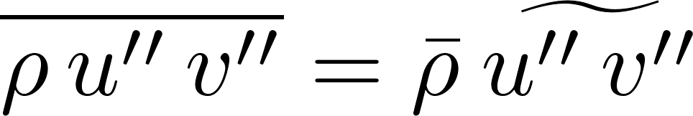
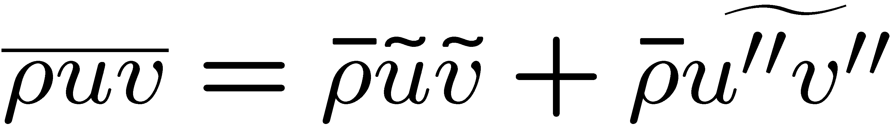
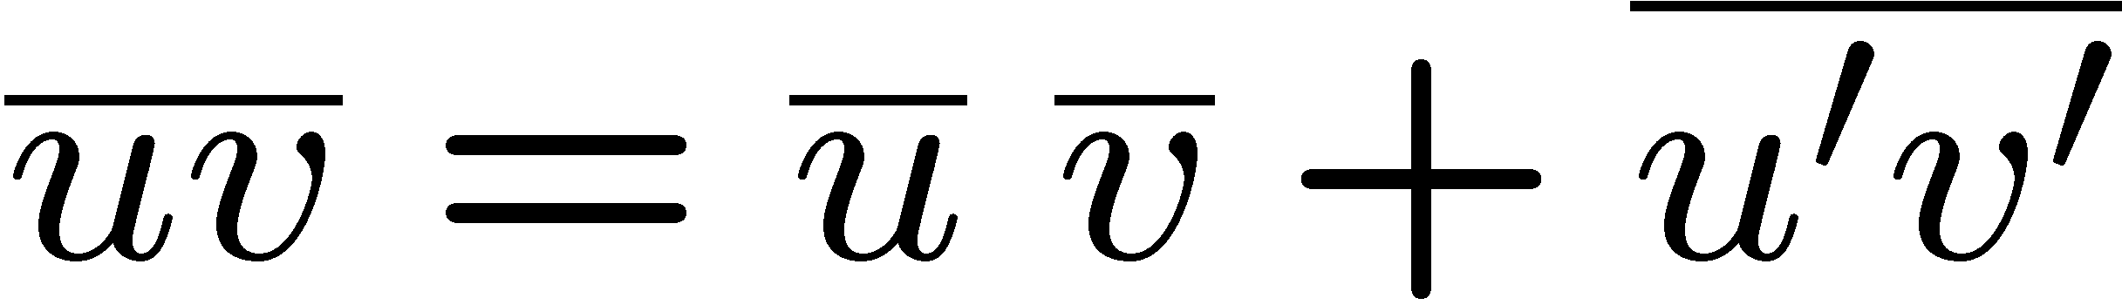
Taking the average leads to
with
this leads to
which has formally the same structure as the conventional average for constant density flows
and is much simpler than
Difficulties arising with Favre averaging in the viscous and diffusive transport terms are of less importance since these terms are usually neglected in high Reynolds number turbulence.
1.-18

Slide 22
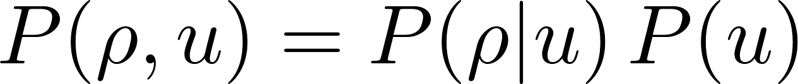
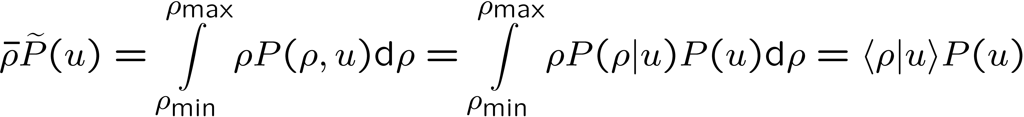
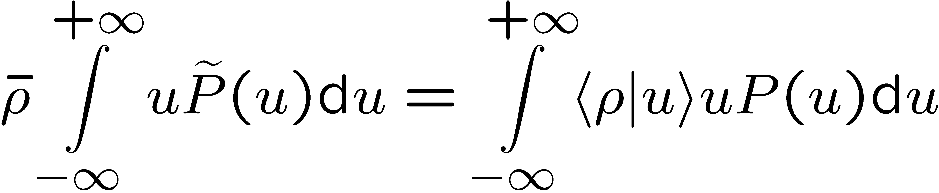
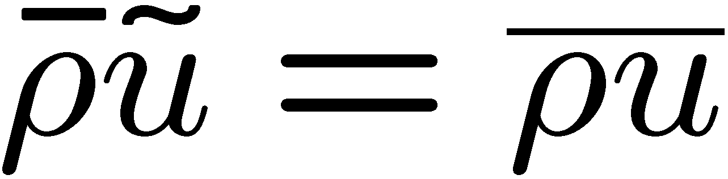
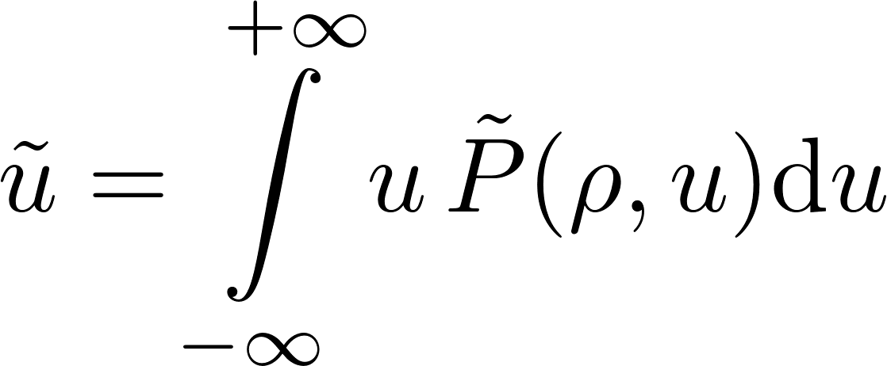
A Favre pdf of u can be derived from the joint pdf P(ρ,u) using Bayes’ theorem
One gets
Multiplying both sides with u and integrating yields
which is equivalent to
The Favre mean value of u therefore is defined as
1.-19

Slide 23
Navier-Stokes Equations and Turbulence Models
The classical approach to model turbulent flows.
It is based on single point averages of the Navier-Stokes equations.
These are commonly called Reynolds Averaged Navier-Stokes Equations (RANS).
We will formally extend this formulation to non-constant density by introducing Favre averages.
In addition we will present the most simple model for turbulent flows,
the k-ε model.
1.-20

Slide 24
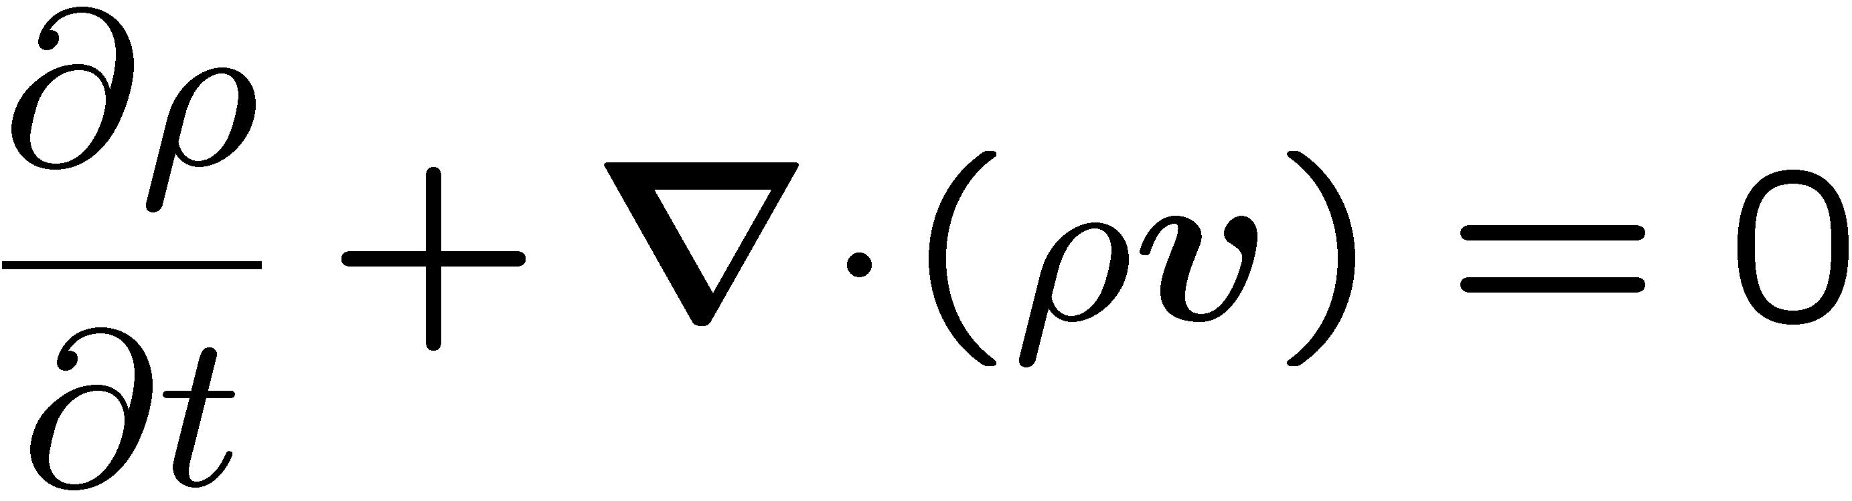
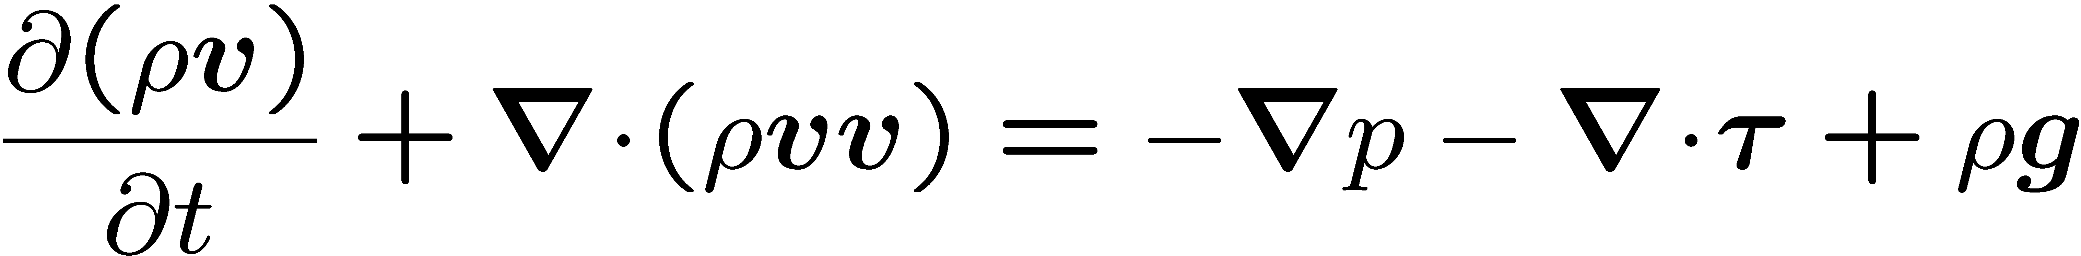
Even though it certainly is the best compromise for engineering problems using RANS, the predictive power of the k-ε model is, except for simple shear flows, often found to be disappointing.
We will present it here, mainly to be able to define turbulent length and time scales.
For non-constant density flows the Navier-Stokes equations are written in
conservative form:
Continuity
Momentum
1.-21

Slide 25
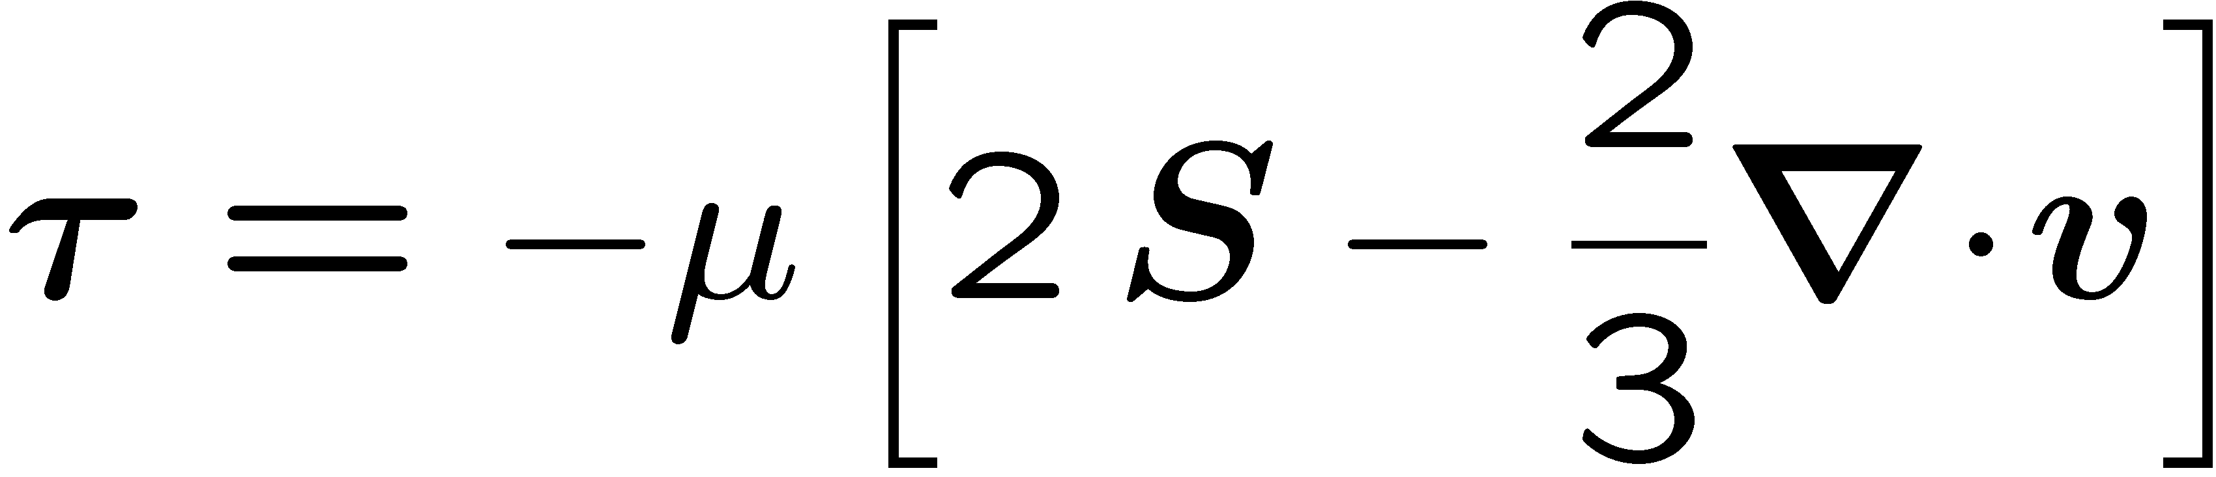
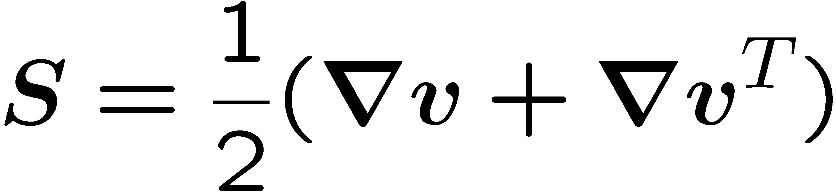
The two terms on the left hand side (l.h.s.) of
represent the local rate of change and convection of momentum, respectively, while the first term on the right hand side (r.h.s.) is the pressure gradient and the second term on the r.h.s. represents molecular transport due to viscosity.
Here τ is the viscous stress tensor
which is proportional to the dynamic viscosity μ =ρ v and contains the
rate of strain tensor
which is the symmetric part of the velocity gradient.
The last term in the viscous tensor represents forces due to buoyancy.
1.-22

Slide 26
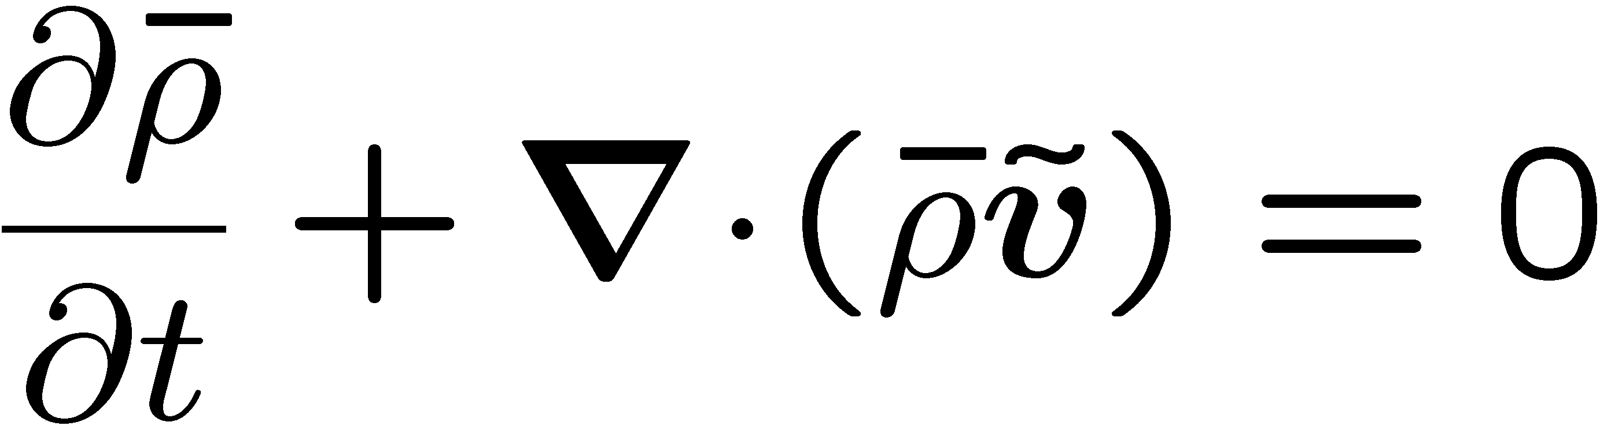
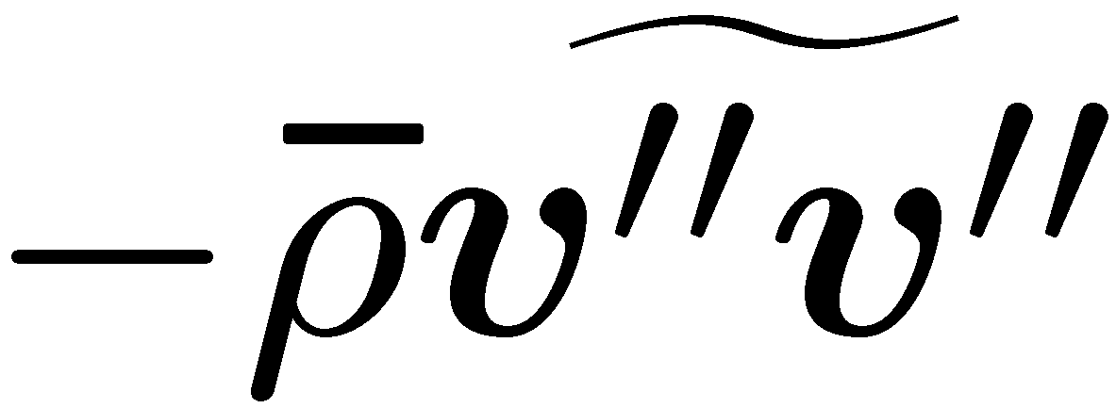
Using Favre averaging and one obtains
This equation is similar to the original Navier-Stokes equation
except for the third term on the l.h.s. containing the correlation
which is new. By analogy it is called the Reynolds stress tensor.
1.-23

Slide 27
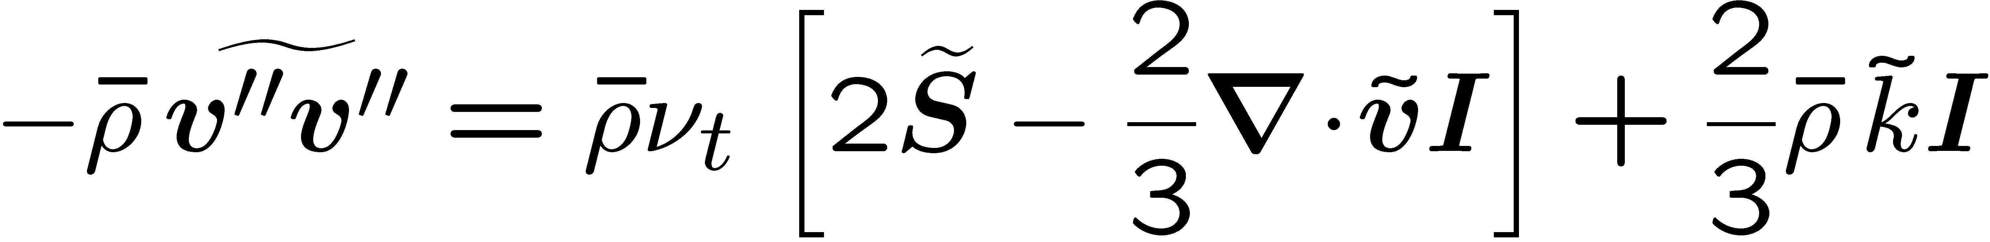
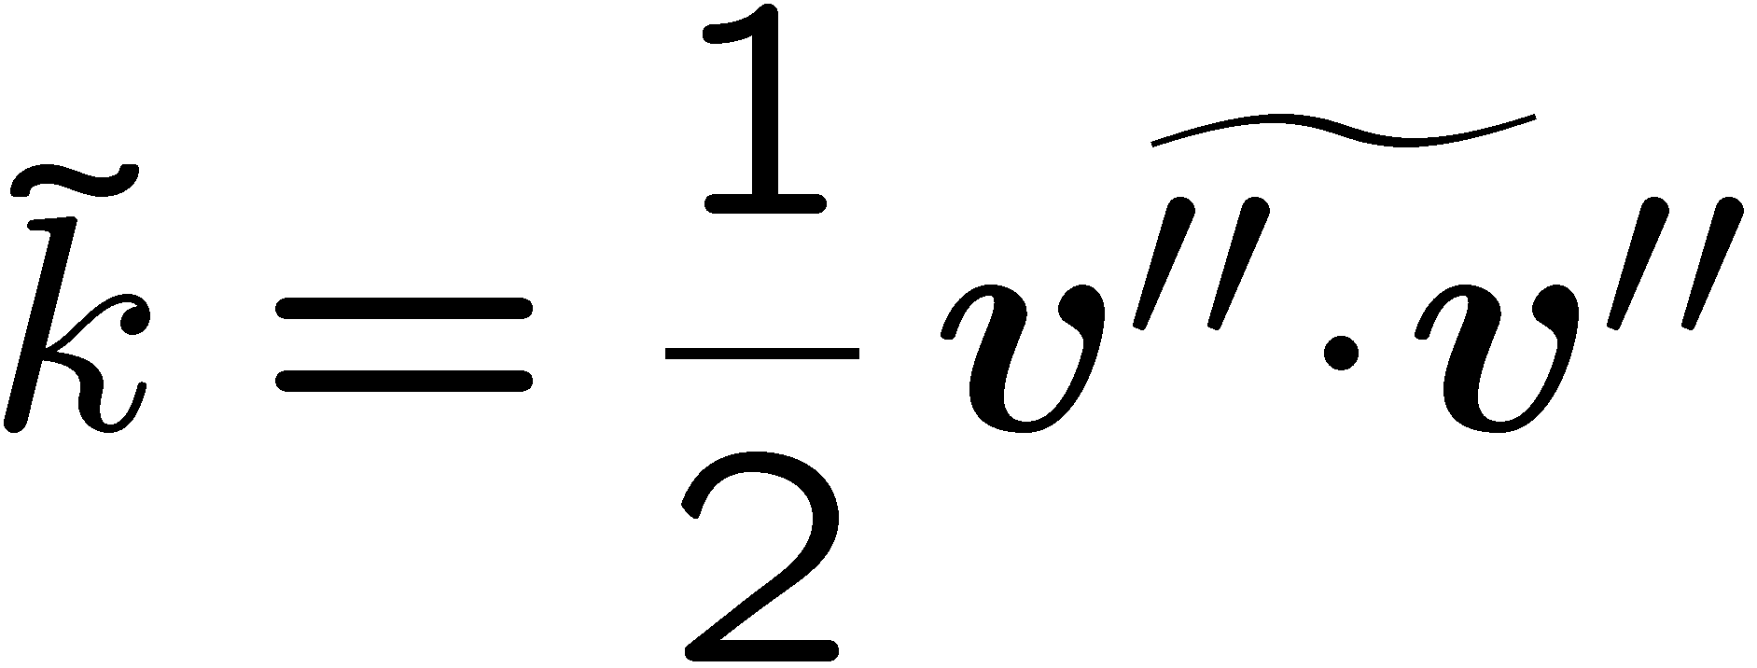

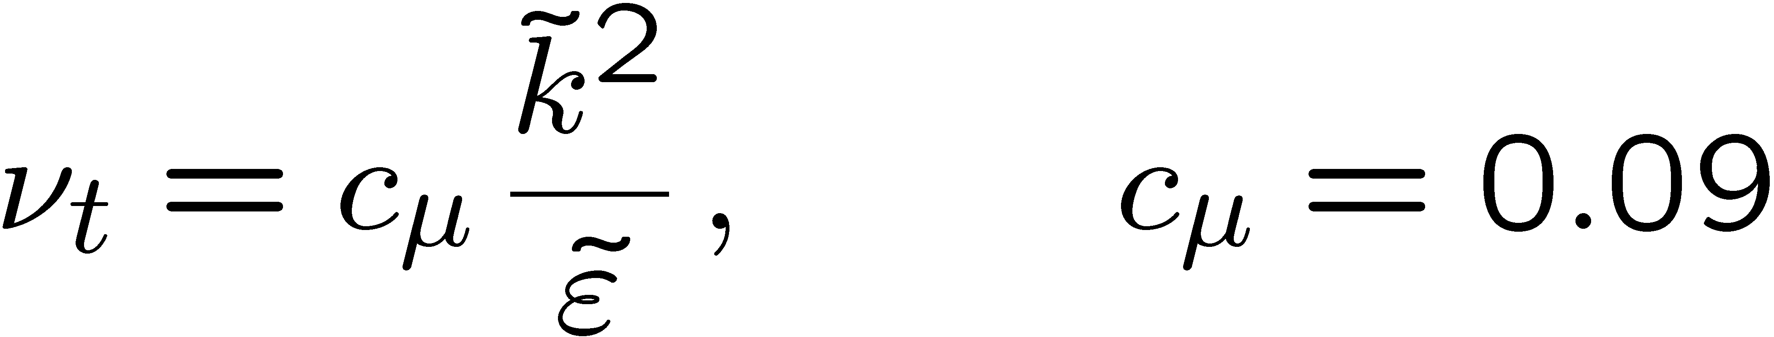
An important simplification is obtained by introducing the
kinematic eddy viscosity ν_{t}
which leads to the following expression for the Reynolds stress tensor
Here I is the unit tensor.
The kinematic eddy viscosity is related to the Favre average turbulent kinetic energy
and its dissipation by
1.-24

Slide 28
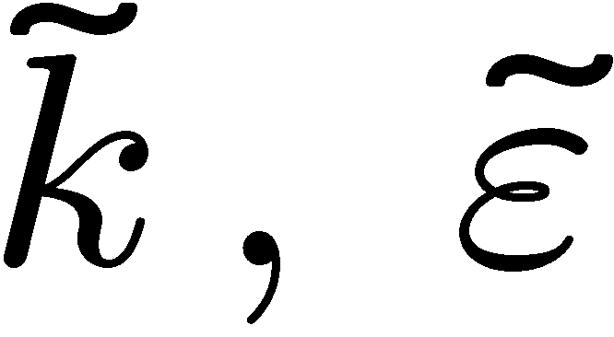
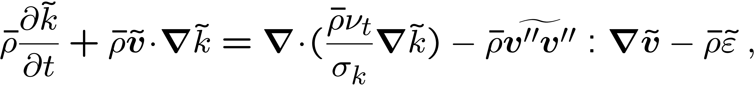
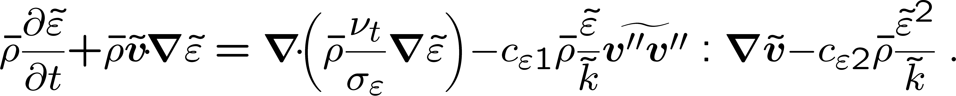
This requires that modeled equations are available for .
These equations are given here in their most simple form:
Turbulent kinetic energy
Turbulent dissipation
In these equations the two terms on the l.h.s. represent the local rate of change and
convection, respectively.
As in the standard k-ε model, the constants
σ_{k}=1.0, σ_{ε} = 1.3, c_{ε1}= 1.44 and c_{ε2}= 1.92
are generally used.
1.-25

Slide 29
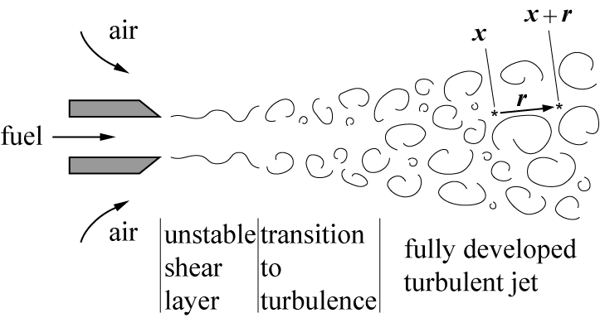
Two-Point Velocity Correlations and Turbulent Scales
A characteristic feature of turbulent flows is the occurrence of eddies of different length scales.
If a turbulent jet enters with a high
velocity into initially quiescent
surroundings, the large velocity
difference between the jet and the
surroundings generate a
shear layer instability which after
a transition, becomes turbulent further downstream from the nozzle exit.
1.-26

Slide 30
The two shear layers merge into a fully developed turbulent jet.
In order to characterize the distribution of eddy length scales at any position within the jet, one measures at point x and time t the axial velocity u(x,t), and simultaneously at a second point (x+r,t) with distance r apart from
the first one, the velocity u(x+r,t).
Then the correlation between these
Two velocities is defined by the
average
1.-27

Slide 31
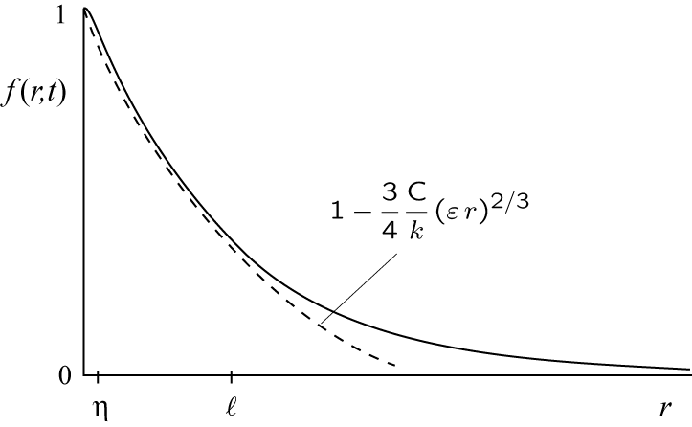
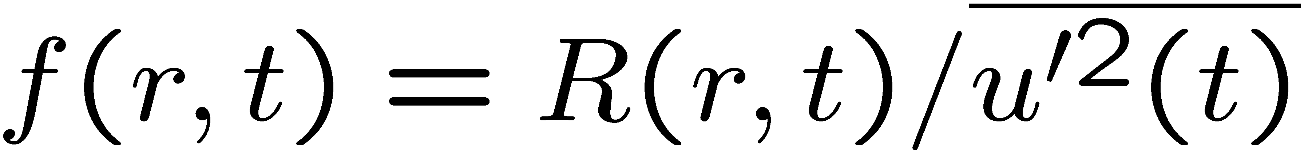
For homogeneous isotropic turbulence the location x is arbitrary and r may
be replaced by its absolute value r = |r|.
For this case the normalized
correlation
is plotted schematically here.
Kolmogorov's 1941 theory for homogeneous isotropic turbulence assumes that there is a steady transfer of kinetic energy from the large scales to the small scales and that this energy is being consumed at the small scales by viscous dissipation.
This is the eddy cascade hypothesis.
1.-28

Slide 32
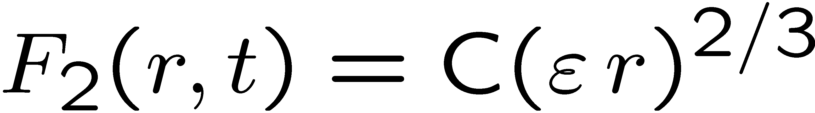
By equating the energy transfer rate (kinetic energy per eddy turnover time) with the dissipation it follows that this quantity is independent of the size of the eddies within the inertial range.
For the inertial subrange, extending from the integral scale to the Kolmogorov scale η, the dissipation ε is the only dimensional quantity apart from the correlation co-ordinate r that is available for the scaling of f(r,t).
Since ε has the dimension m²/s³, the second order structure function defined by
with the dimension m²/s² must therefore scale as
where C is a universal constant called the Kolmogorov constant.
1.-29

Slide 33
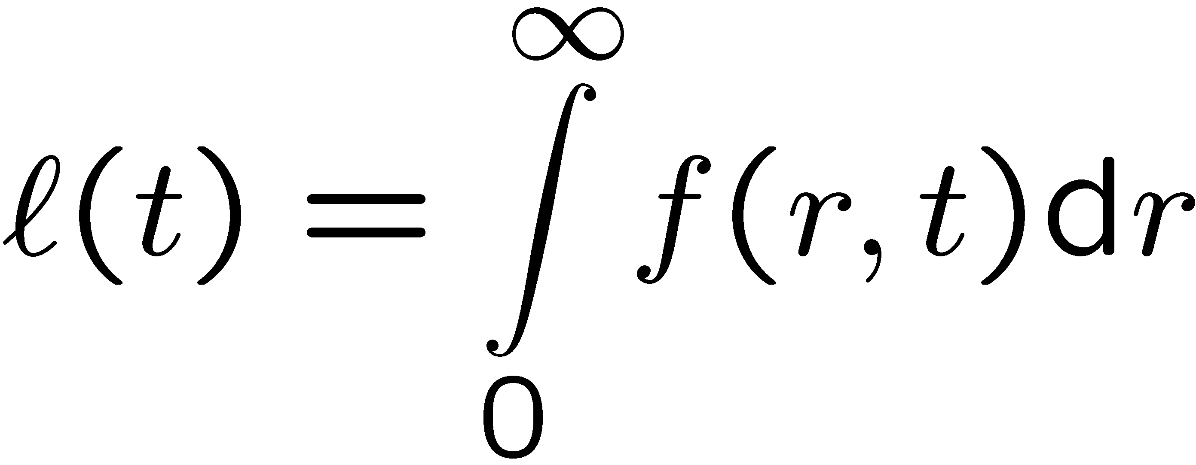
There are eddies of a characteristic size which contain most of the kinetic energy.
At these eddies there still is a relatively large correlation f(r,t) before it decays to zero.
The length scale of these eddies is called the integral length scale defined by
1.-30

Slide 34
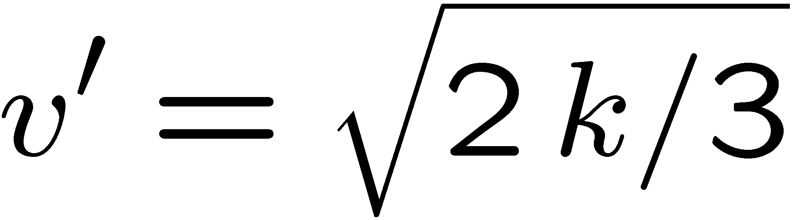
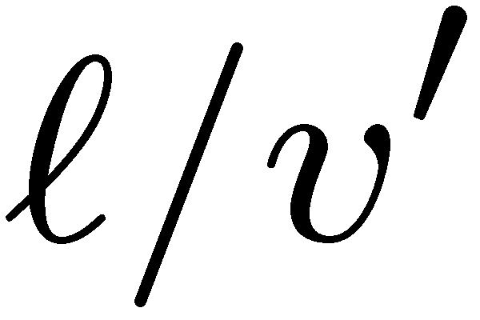
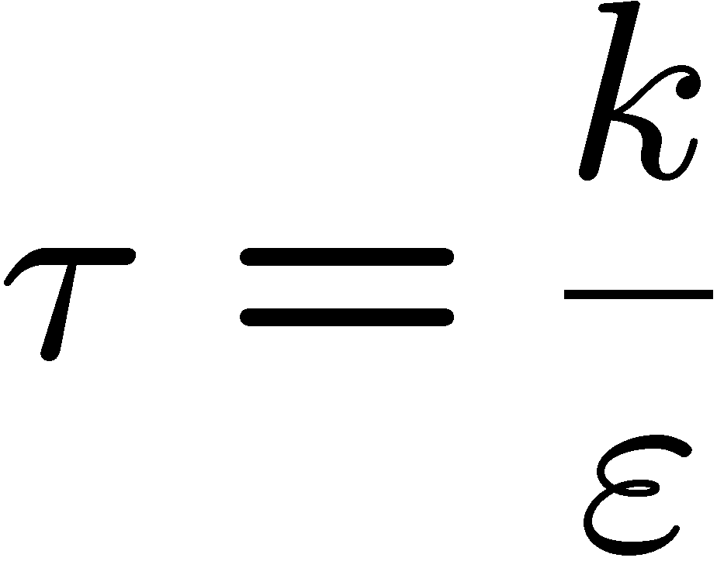
We denote the root-mean-square (r.m.s.) velocity fluctuation by
which represents the turnover velocity of integral scale eddies.
The turnover time
of these eddies is then proportional to the integral time scale
For very small values of r only very small eddies fit into the distance
between x and x+r.
1.-31

Slide 35
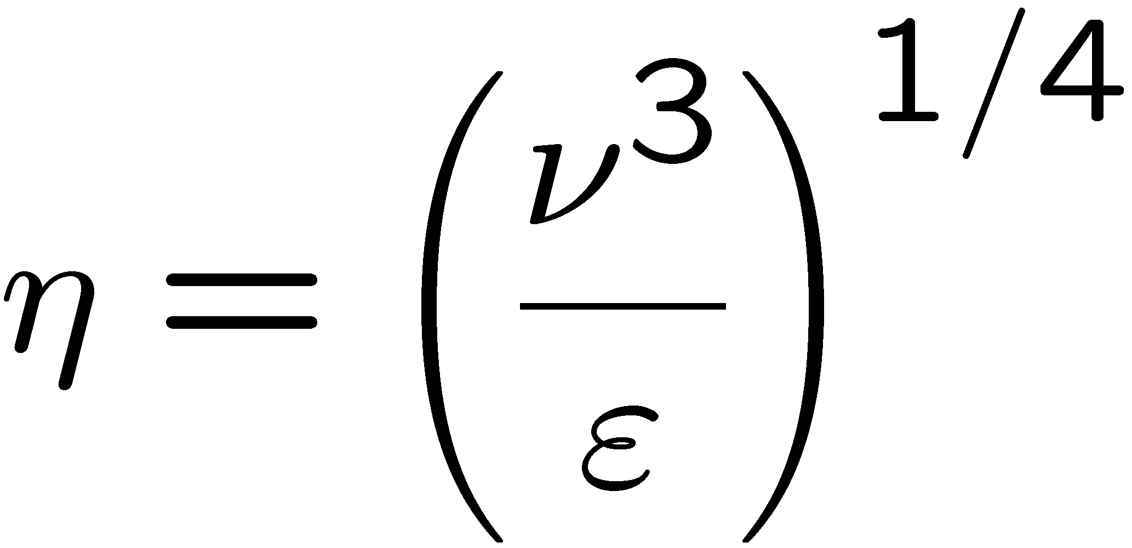
The motion of these small eddies is influenced by viscosity which provides an additional dimensional quantity for scaling.
Dimensional analysis then yields the Kolmogorov length scale
The range of length scales between the integral scale and the Kolmogorov scale is called the inertial range.
1.-32

Slide 36
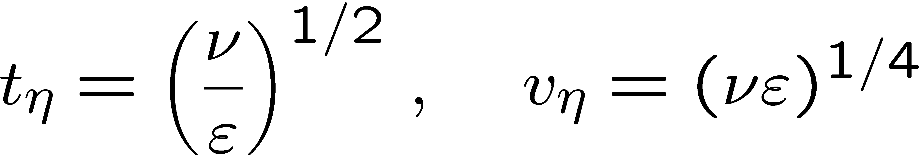

In addition to η a Kolmogorov time and a velocity scale may be defined as
According to Kolmogorov's 1941 theory the energy transfer from the large eddies of the integral scale is equal to the dissipation of energy at the Kolmogorov scale.
Therefore we will relate ε directly to the turnover velocity and the length scale of the integral scale eddies
1.-33

Slide 37



We now define a discrete sequence of eddies within the inertial subrange by
Since ε is constant within the inertial subrange, dimensional analysis relates the turnover time and the velocity difference across the eddy size to ε in that range as
This relation includes the integral scales and also holds for the Kolmogorov scales as
1.-34

Slide 38



A Fourier transform of the isotropic two-point correlation function leads to a
definition of the kinetic energy spectrum E(k), which is the density of
kinetic energy per unit wave number k.
Here, rather than to present a formal derivation, we relate the wave number k to the inverse of the eddy size as
The kinetic energy v_{n}² is then
and its density in wave number space is proportional to
This is the well-known k^{-5/3} law for the kinetic energy spectrum\label in the inertial subrange.
1.-35

Slide 39

If the energy spectrum is measured in the entire wave number range one obtains the
behavior shown schematically in the log-log plot .
For small wave numbers
Corresponding to large
scale eddies the energy per
unit wave number increases
with a power law between
k² and k⁴.
This range is not universal
and is determined by large scale instabilities which depend on the boundary conditions of the flow.
1.-36

Slide 40
The spectrum attains a maximum at a wave number that corresponds to the integral scale, since eddies of that scale contain most of the kinetic energy.
For larger wave numbers
corresponding to the inertial
subrange the energy spectrum
decreases following the k^{-5/3} law.
There is a cut-off due to viscous
effects at the Kolmogorov scale η.
Beyond this cut-off, in the range
called the viscous subrange, the
energy per unit wave number decreases exponentially due to viscous effects.
1.-37

